Slide 1
Map Coordinates Extraction in Video Images
Flat Angles Problem and Possible Solutions
Yoav Rosenberg

Slide 2
Protrack: Technology and Applications
Video Stabilization and Enhancment
Motion Detection and Classification
Unattended\Abandoned Object Detection
Object Tracking
Exact Coordinates extraction
Geo-referenced Mosaics
For airborne and ground cameras

Slide 3
Map Coordinates Extraction – based on camera’s physical data
Given:
Video image
Camera’s GPS approximated position - O
Camera’s approximated Field of View - FOV
Approximated view angles - V
DEM – Digital Elevation Model
The Problem:
Compute the map coordinates P of a pixel p in the video image
Compute the approximated camera model - M
Compute the line of sight going through p
Intersect the line with the DEM and find P
O
p
V
P

Slide 4
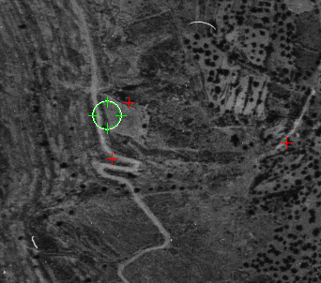
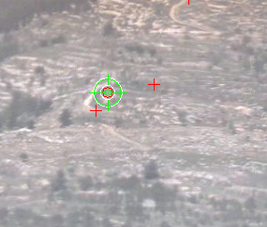
Map Coordinates Extraction – based on Image Matching
very accurate results can be achieved by using a system which matches the image to an Orthophoto (Orthogonal Aerial Photo)
Approximate Camera Model M
Rendered Image
T_{1,2}
Image Correlator (Image Matching)
T_{1,2} x M
Renderer
Accurate Camera Model
Orthophoto + DTM
Video Image

Slide 5
Continuous Video Matching
Several technics can be used to allow continuous coordinates extraction in real-time video:
Compute the motion between consecutive video frames to predict the camera model in the next frame
If direct video matching failed, previously matched images can be used instead

Slide 6
Continuous Video Matching - Demo
ProTrack’s MAOF system

Slide 7
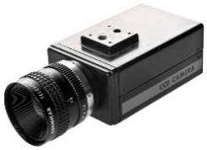
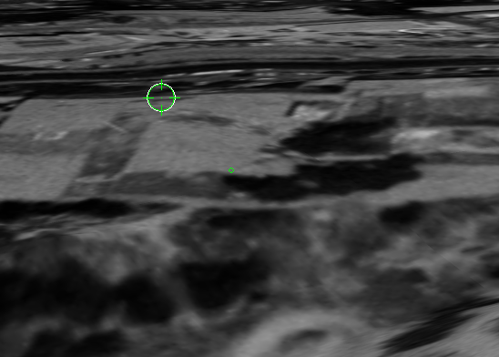
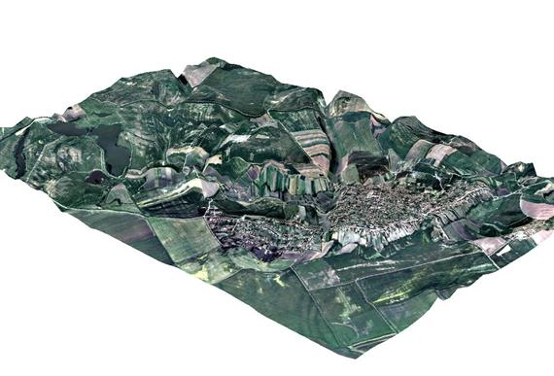
The Flat Angle Problem
Matching a video from a flat angle camera is problematic:
The Orthophoto is created from a bird’s view angle
The DEM does not reflect the earth’s cover
Rendered Image
Near- Orthogonal
View Point
Renderer
Ground Camera
Orthophoto
Video Image

Slide 8
Flat Angle Problem - Example
Original Orthophoto
Rendered View
Ground Camera View

Slide 9
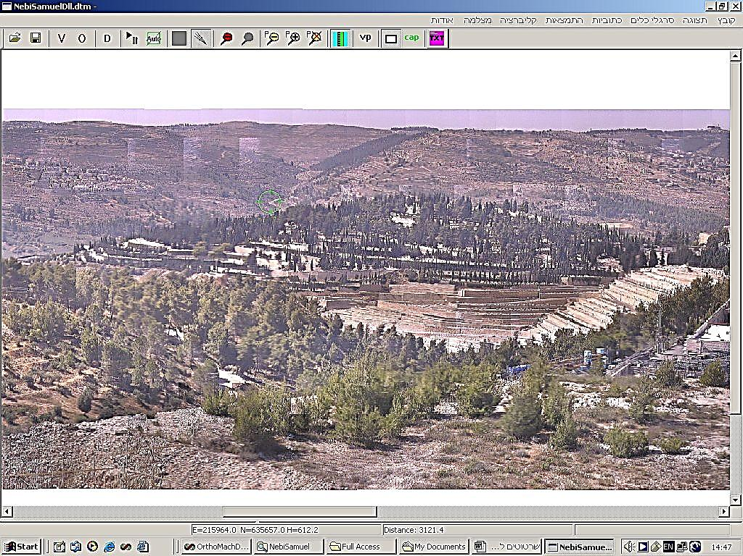
Solving the Flat Angle problem for Fixed Cameras
Build and use a geo-referenced mosaic taken from the observer’s location
350º
0º
10º
1º
0º
-1º

Slide 10
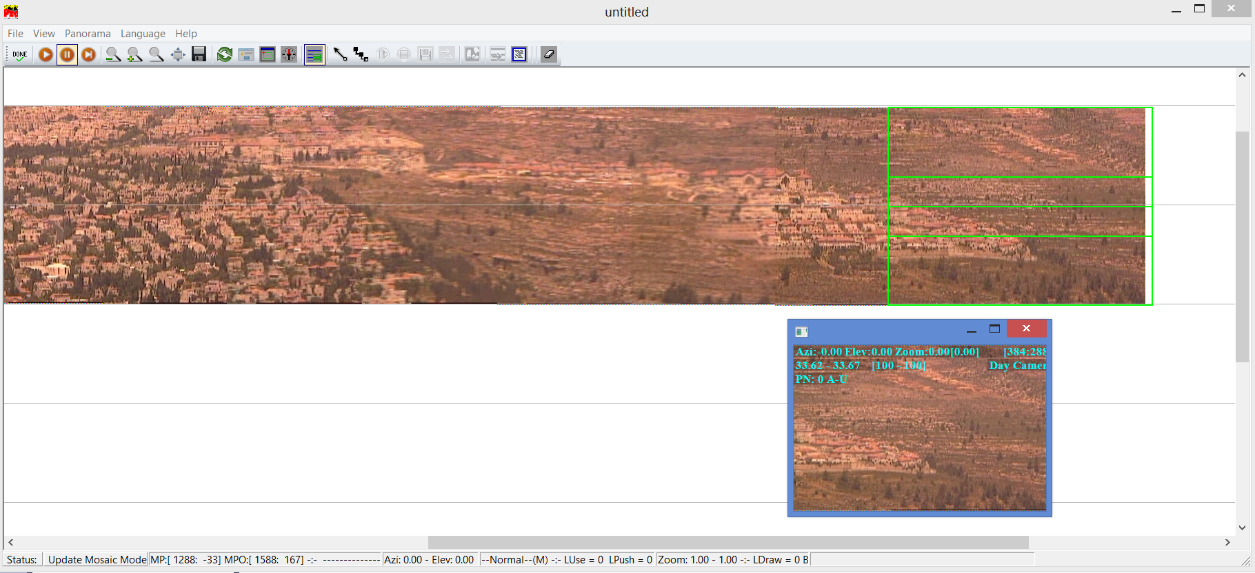
Fixed Camera Solution (cont.)
Building the Mosaic

Slide 11
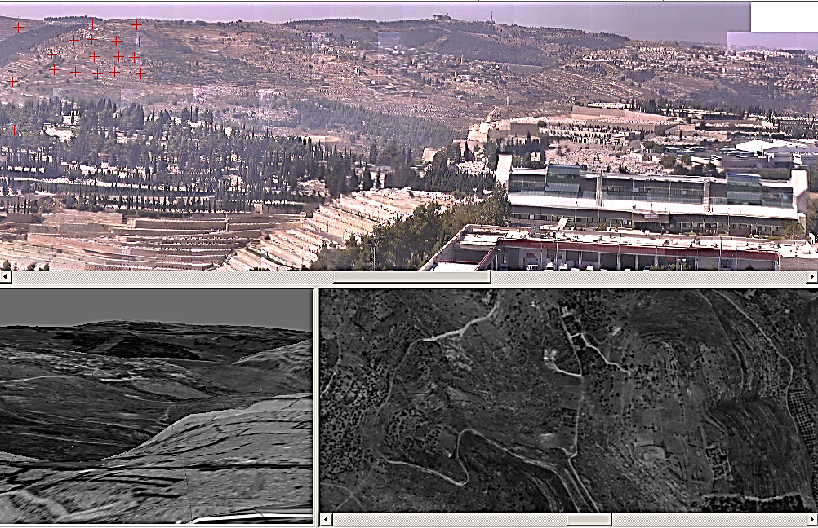
Fixed Camera Solution (cont.)
Matching the mosaic to the rendered Orthophoto
Orthophoto rendered to the camera viewpoint
Orthophoto

Slide 12
Fixed Camera Solution (cont.)
Solving the mosaic
1
2
3
4
17
23
M _{1,2}
M _{2,3}
M _{3,4}
M _{4,5}
M _{16,17}
M _{17, 18}
M _{23, 24}
M _{I,j} transformation matching between images
T₁₇
T₂₃
T_{I} = Successful matching of video frame i to the Orthophoto

Slide 13
Fixed Camera Solution (cont.)
M _{I,j}
T _{I}
C _{I} =
Appr. Camera position of video frame
Bundle Adjustment
Solved mosaic
P_{i,j} = Azimuth and Elevation
The mosaic can be solved with relatively sparse matching to the Orthophoto

Slide 14
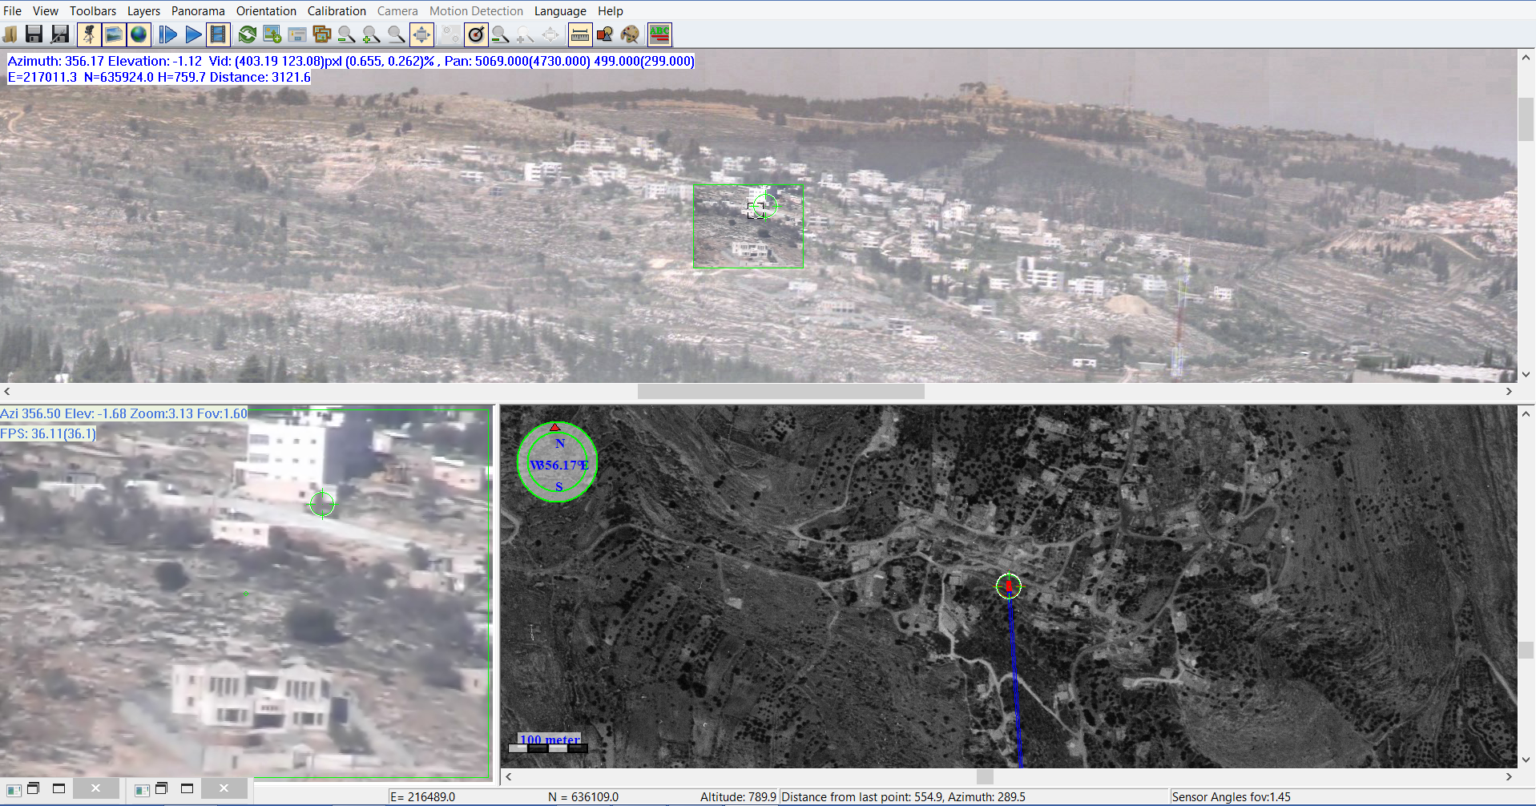
Fixed Camera Solution (cont.)
Matching the video to the anchored mosaic

Slide 15
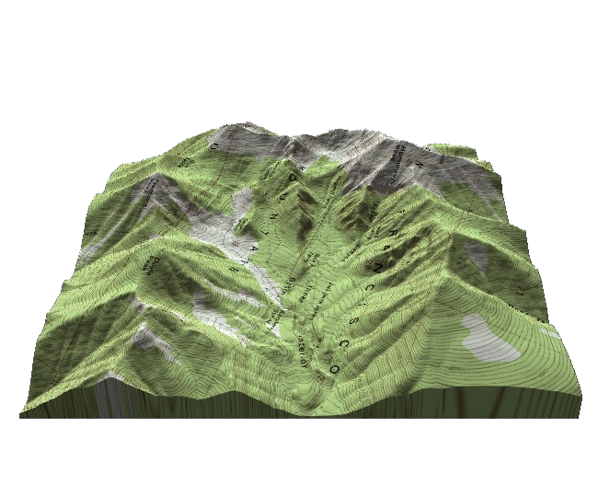
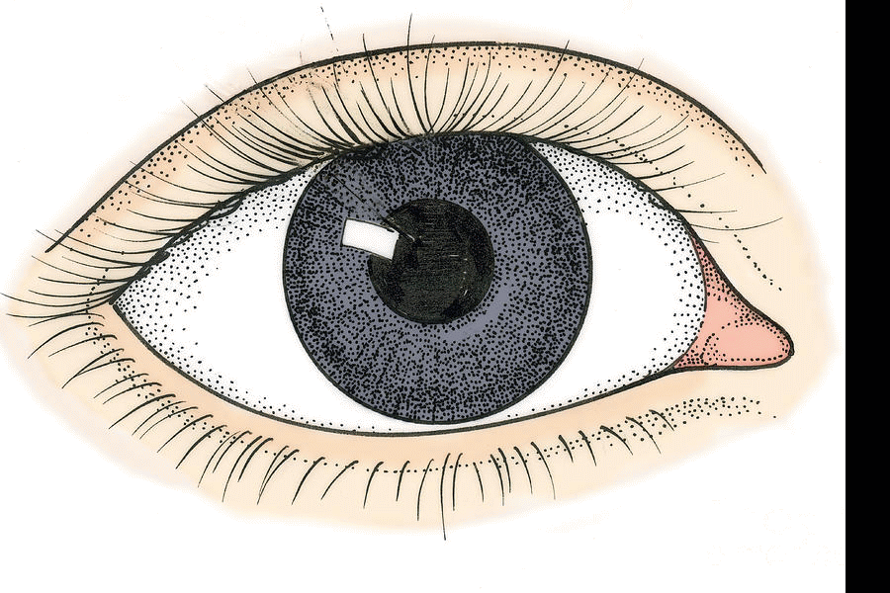
Orthophoto vs. Anchored Mosaic
Orthophoto
P _{I,j} → X,Y,Z
Anchored Mosaic
P _{I,j} → Azimuth & Elevation
Real World

Slide 16
Extracting the map coordinates of a pixel in the panoramic view
Given the camera location and view angle, the line of sight is intersected with the Digital Elevation Map (DEM) in order to get the map coordinates
Traverse
Elevation
Ground Intersection Point

Slide 17
Example
ProTrack’s MAOF system

Slide 18
Ambiguity in Flat Angles

Slide 19
Solving Ambiguities with DSM

Slide 20
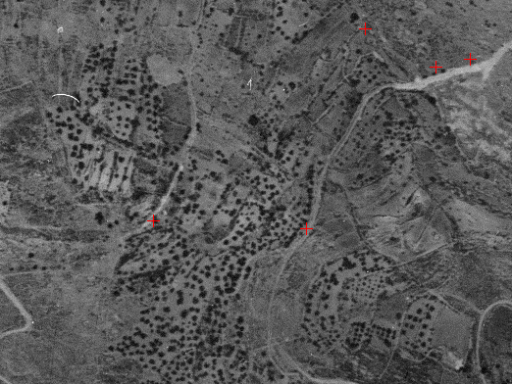
Solving Ambiguities without DSM (cont.)
Using 2 mosaics from different view points (~10º)
Orthophoto
Ambiguity Zone
I
Video

Slide 21
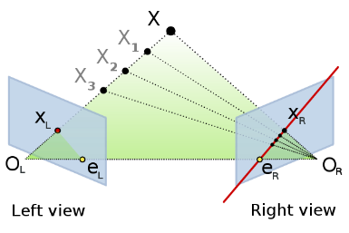
Solving Ambiguities without DSM (cont.)
Search the target along the Epipolar line
Orthophoto
Ambiguity Zone
I
I
Epipolar Line
Video

Slide 22
Solving Ambiguities without DSM (cont.)
Orthophoto
Ambiguity Zone
I
I
Video

Slide 23
Solving Ambiguities without DSM (cont.)
Using an Aerial photo
Aerial photo
I
I
Ground Mosaic

Slide 24
Thank You
Yoav@protrack.co.il

